Slide 1


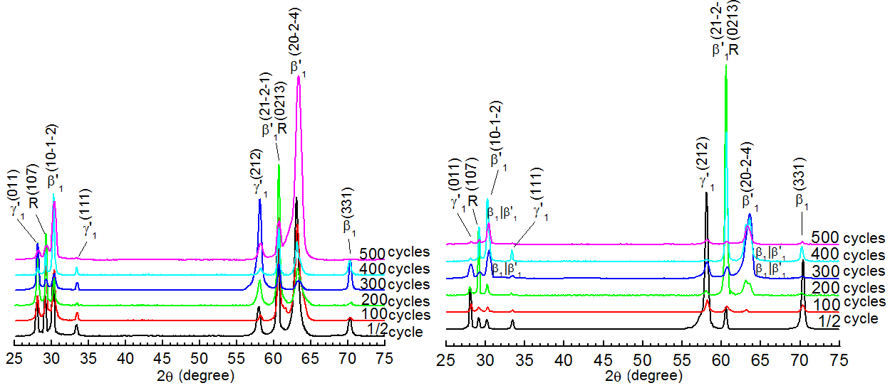
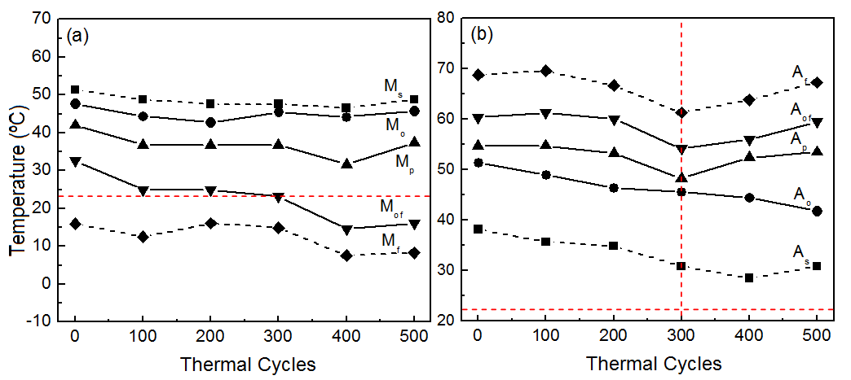
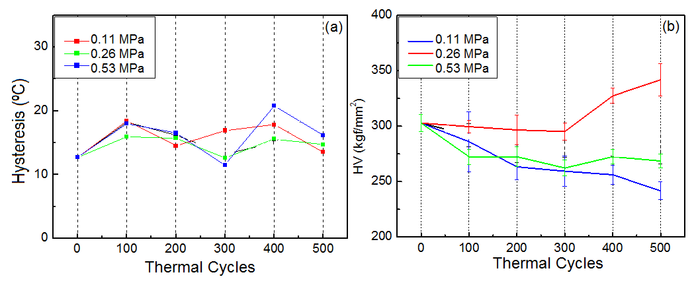
Structural characterization and DSC analysis of monocrystalline Cu-Al-Ni alloy submitted to thermo-cycling under applied loading
Dr. Lioudmila A. Matlakhova*¹⁾, Elaine C. Pereira¹⁾, Carlos Y. Shigue ²⁾, Ivan E. Vahhi³⁾, Segei A. Pulnev⁴⁾, Natalia A. Palii ⁵⁾
*¹ Associate Professor, ¹⁾Northern Fluminense State University - Darcy Ribeiro, RJ, Brazil
²⁾DEMAR-USP, SP, Brazil; ³⁾Institute of Geoecology - RAS, Russia; ⁴⁾Ioffe Institute, Russia; ⁵⁾IMET A.Baykov - RAS, Russia
Results
Abstract
Monocrystalline alloy with the nominal composition Cu-13.7%Al-4.2%Ni (wt.%), which exhibits reversible martensitic transformations (RMT), was studied. The alloy, produced at Ioffe Institute (Russia) through the EFG process (the Stepanov method), was subjected to thermocycling in complete interval of RMT. Much attention was devoted to the physical and structural characterization of the alloy submitted to the thermo-cyclic treatment (TCT), up to 500 cycles under applied loads, corresponding to deformation by compression of 0.11; 0.26 and 0.53 MPa, which induce merely elastic stresses in the specimens. X-ray diffraction analysis, optical microscopy, differential scanning calorimetry and Vickers microhardness were involved in the alloy characterization.
Results
Figure 2. XRD patterns of the Cu-13.7Al-4.2Ni alloy subjected to TCT of 100, 200, 300, 400 and 500 thermal cycles under applied loading by compression of 0.53 MPa , finishing with a ½ cooling cycle (a) and ½ heating cycle (b).
Figure 3. Variation of the critical RMT temperatures, obtained by DSC for the Cu-13.7Al-4.2Ni alloy, with the number of thermal cycles under applied loading by compression of 0.53 MPa for: (a) cooling and (b) heating.
Figure 4. Variation of the RMT hysteresis (a) and microhardness vickers HV (b) with the number of thermal cycles under applied loading by compression of 0.11; 0.26 and 0.53 MPa for the Cu-13.7Al-4.2Ni .
Conclusions
The alloy displays complex transformations, revealing the sequence of RMT β₁ ↔ R ↔ β′₁ + γ′₁ ; these coherent phases are very sensitive to the experimental conditions. The results show that in the TTC, performed under optimized loading (0.26 MPa), the processes of reorientation, hardening and stabilization of the structure during RMT proceeds more intensively, resulting in the critical intervals reduction, and the microhardness increase if the number of thermal cycles exceeds 300.
Figure 1. Microstructure of the Cu-13.7Al-4.2Ni alloy after 500 thermal cycles under applied loading by compression of 0.11 (a,b); 0.26 (c,d) and 0.53 (e,f) MPa, finishing with a ½ cooling cycle (a,c,e) and ½ heating cycle (b,d,f).
References
[1] Kurdiumov, G.V., Handros, L.G. (1949) Equilíbrio Termoelástico em Transformações Martensíticas. Doklady Akademii Nauk. SSSR. n. 2. p. 214-221.
[2] Otsuka, K., Wayman, C.M. (1999) Shape Memory Materials. 1ª ed. University Press. United Kingdom-Cambridge, USA. 284p.
[3] Priadko A, Pulnev S, Viahhi I, Vetrov V, Yudin V. Proc of the Institute of Robotics and Technical Cybernetics. Actuators and Drives Based on Cu-Al-Ni Shape Memory Single Crystals. St-Petersburg, Russia, 21p., 2000.

